Slide 1

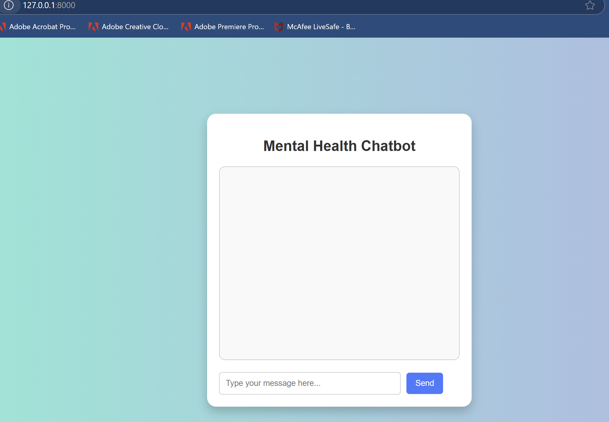
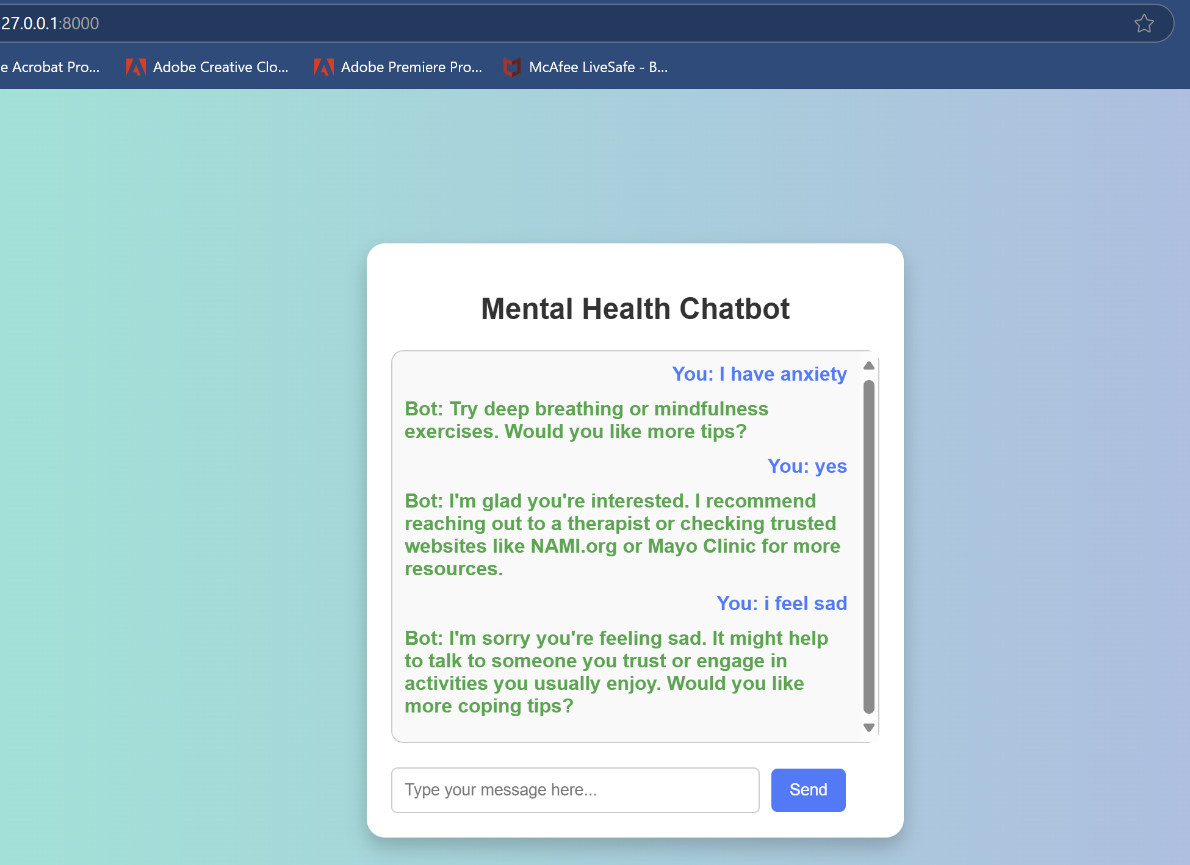
Mental Health & Medication Education Chatbot
"Providing supportive mental health tips and trusted medication education through a simple AI chatbot."
Blanche Payton

